Slide 1

Friendship Paradox and Network Evolution
A Study of Synthetic Networks and Time Evolution
Presented by:
Erta Tershana

Slide 2
Introduction
The Friendship Paradox states that, on average, your friends have more friends than you.
This project uses synthetic networks to analyze this paradox.
We study network growth and evolution over time.

Slide 3
Methodology
We also studied network evolution over time.
We generated synthetic
networks using:
Erdős–Rényi (Random) Model
Barabási–Albert (Scale-Free) Model
Watts–Strogatz (Small-World) Model
The Friendship Paradox was analyzed by computing:
Node Degree vs. Average Neighbor Degree

Slide 4
Synthetic Network Models
Nodes connect randomly.
Erdős–Rényi
New nodes attach preferentially to highly connected nodes.
Barabási–Albert
Models small-world networks with rewiring.
Watts–Strogatz

Slide 5
Friendship Paradox Analysis
Degree of each node was compared to the average degree of its neighbors.
Stronger in scale-free networks due to highly connected hubs.
Results confirmed that, on average, neighbors have more connections.
“Mercury is the closest planet to the Sun and the smallest one in the Solar System”

Slide 6
Time Evolution of Networks
Simulated network growth over time using the Barabási–Albert model.
Visualization shows how the network evolves and the paradox strengthens.
Nodes were added dynamically, following preferential attachment.

Slide 7
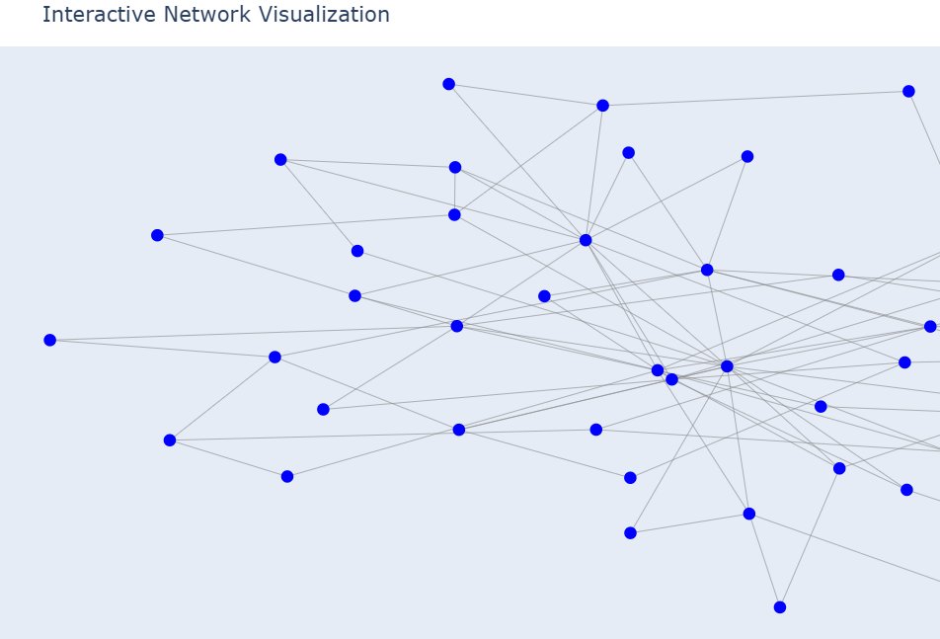
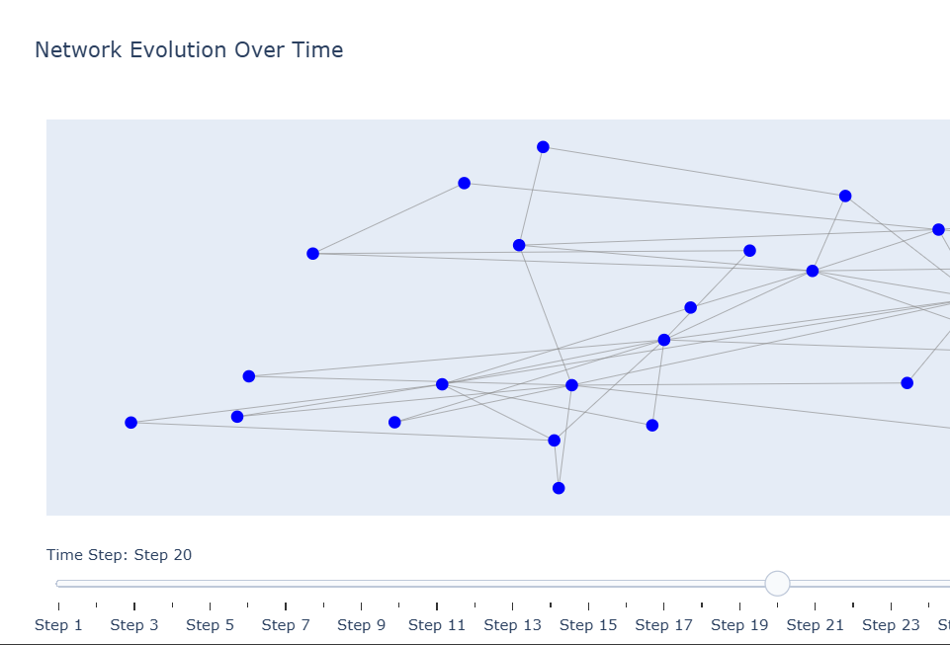
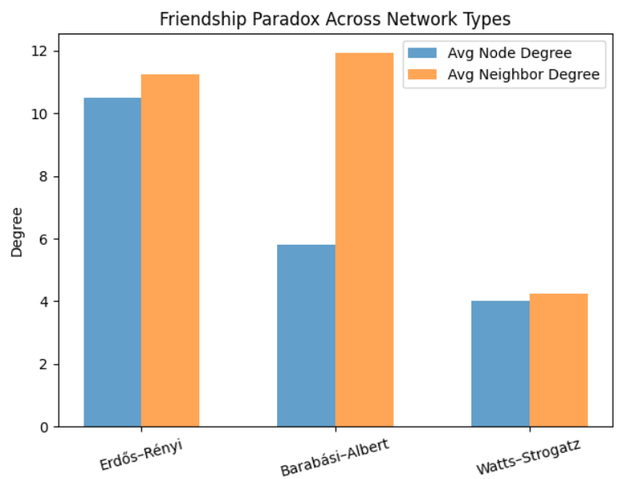
Results & Visualizations
 | Animated visualization of network growth. |  | Bar charts comparing node degree vs. neighbor degree across network types.
 |  | Interactive Plotly visualization for exploring network structure.

Slide 8
Conclusion
The Friendship Paradox holds across different synthetic networks.
Time evolution reinforces the paradox as new nodes attach to well-connected hubs.
Applications: Social networks, epidemiology, marketing, and network science.
The effect is strongest in scale-free networks due to hub nodes.

Slide 9
Thank You For Your Attention!
Questions?

